Slide 1
Camille Utterback and Tangible Interaction
By Laura Sugiyama-flores

Slide 2
Camille Utterback
Born in Bloomington Indiana
Attended Williams College for her undergraduate and received a masters in the Interactive Telecommunications program at NYU’s Tisch School of the Arts.
Taught media art at Parsons, NYU’s Tisch School of the Arts and currently teaches at Stanford University.

Slide 3
Recent works
Her work explores linking movement to computational systems.
She writes custom software and combines it with sensing and display technologies.
Creates site specific installations as well as reactive objects.
“Entangled” 2015
‘Liquid Time Tenderloin” 2009
“Text Rain” 1999, collaboration with Romy Achituv

Slide 4
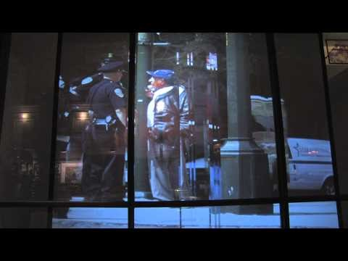
Liquid time tenderloin 2009
Instillation work in the Tenderloin district in San Francisco CA.
Projects pre-recorded video clips from around the neighborhood.
Displayed in the window of the Gray Area Foundation for the Arts.
Passerby movement fragments time in the clips as people walk by.
Meant to create a space that includes multiple times and perspectives.

Slide 5
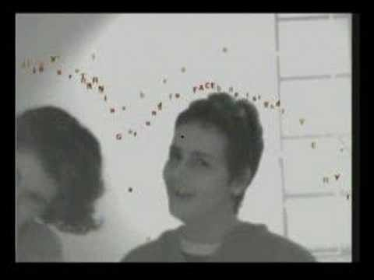
Text Rain (1999)
Projected images of falling letters that can be “caught” and interacted with.
The letters form the lines of a poem.
Intended to create a mental and physical experience for the viewer.

Slide 6
Tangible Interaction
Collaborative group based in Vancouver BC.
Established in 2006.
Creates sensory instillations, branded experiences, public art and experimental products.
Led by Creative Director Alex Beim.

Slide 7
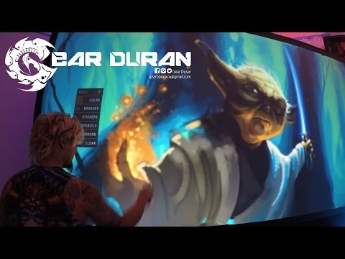
Graffiti Wall
Projection screen that mimics the experience of graffiti.
Realistic digital spray can and customizable options.
Has been used and customized for many different events such as product launches, concerts and in night clubs.
Can be rented for events and customized.
VR components available.

